Slide 1

My Machine Learning Project
By James Schwantes

Slide 2
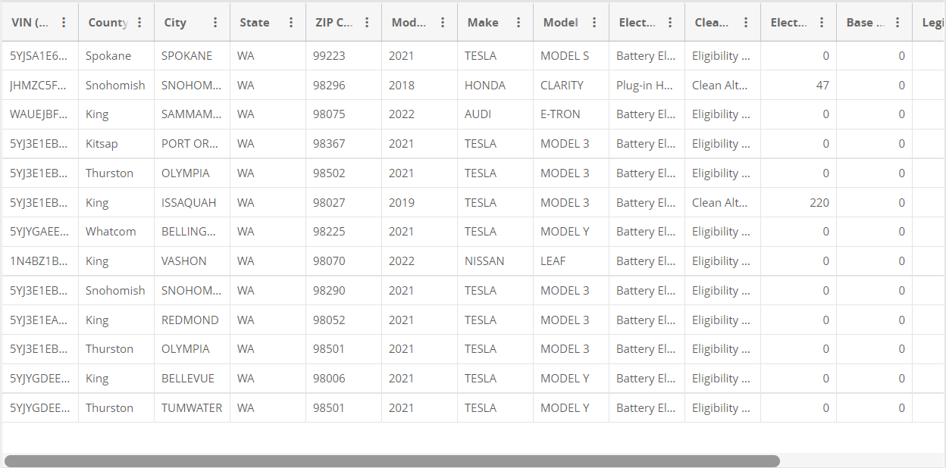
https://data.wa.gov/Transportation/Electric-Vehicle-Population-Data/f6w7-q2d2

Slide 3
My Goal for this Project
My Original Goal: Find the Top 10 Best Cars (along with the cars’ Year, Make, Model), that could designated as a clean alternative.
This Goal was impractical due to the algorithm.
My New Goal: Find the best of one feature, based on two features, in which a car could be designated as a clean alternative.
Maximum Curb Weight in lbs vs Electric Range.

Slide 4
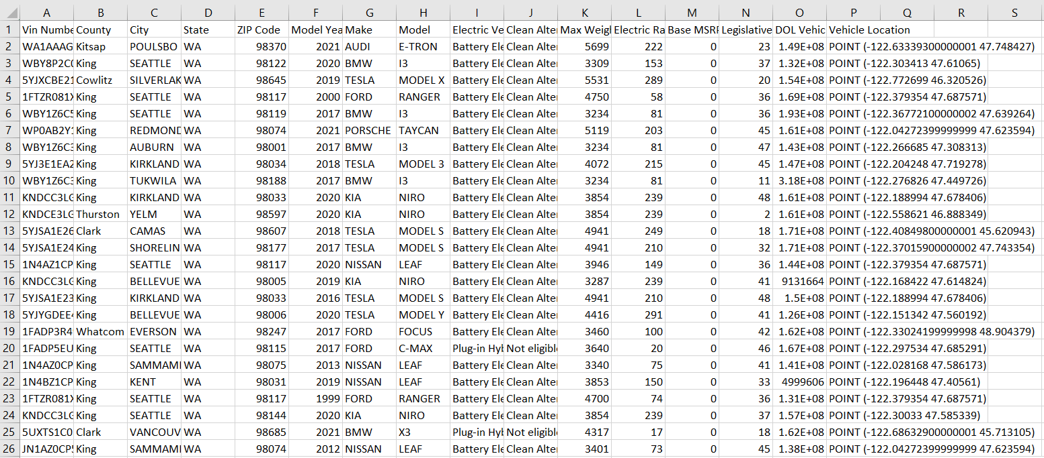
https://data.wa.gov/Transportation/Electric-Vehicle-Population-Data/f6w7-q2d2

Slide 5
LIVE DEMO

Slide 6
Quick Note Before I Show the Graphs
Due to time, I was only able to research into the First 800 Vehicles

Slide 7
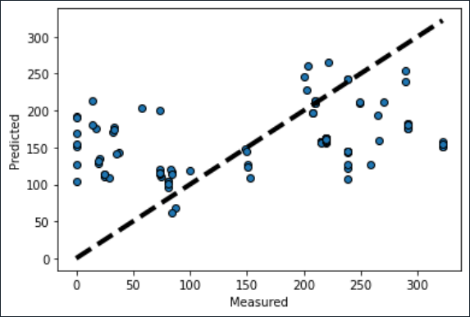
100 Vehicle Graph

Slide 8
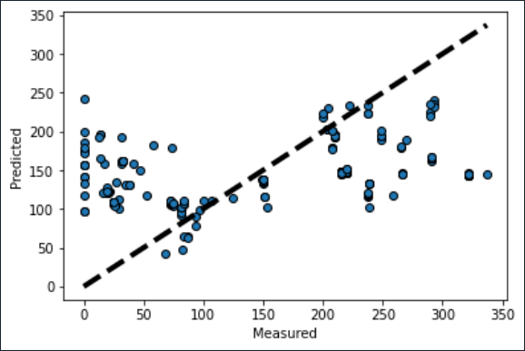
200 Vehicle Graph

Slide 9
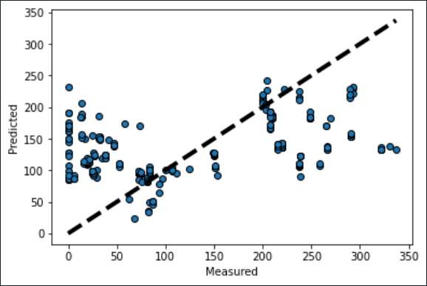
300 Vehicle Graph

Slide 10
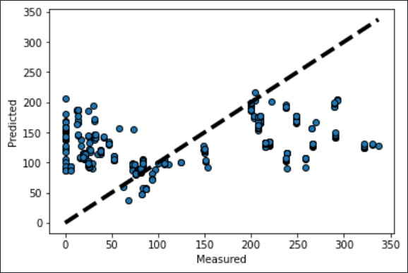
400 Vehicle Graph

Slide 11
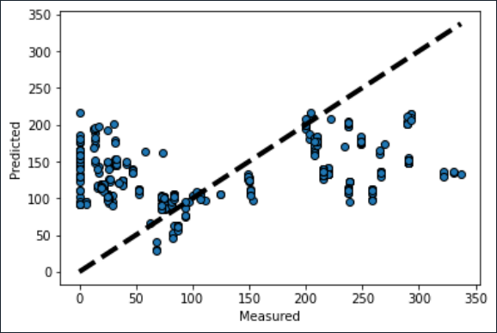
500 Vehicle Graph

Slide 12
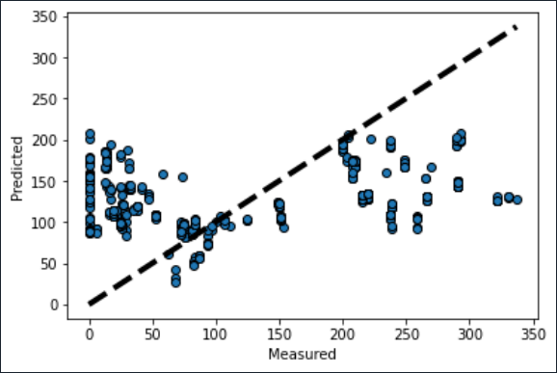
600 Vehicle Graph

Slide 13
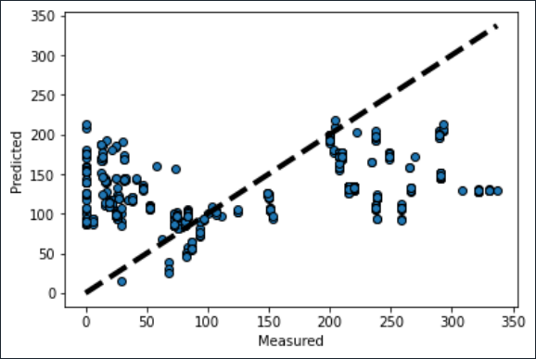
700 Vehicle Graph

Slide 14
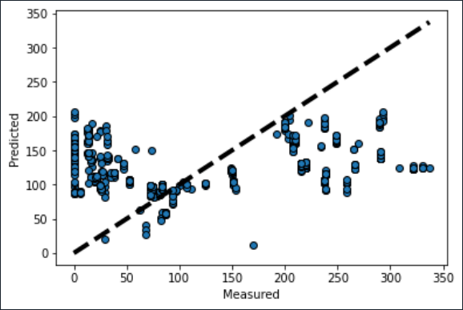
800 Vehicle Graph

Slide 15
In conclusion
Based on Electric Range, 200 seems to be the best range predicted range for an Electric Car, based on weight.
A better algorithm could be used for this project.
There were a lot of identical weights in the Max Weight Category.
More time Researching could make an impact on results.
Overall, the Algorithm was one of the better suited algorithms for this project.

Slide 16
Any Questions?

